Slide 1
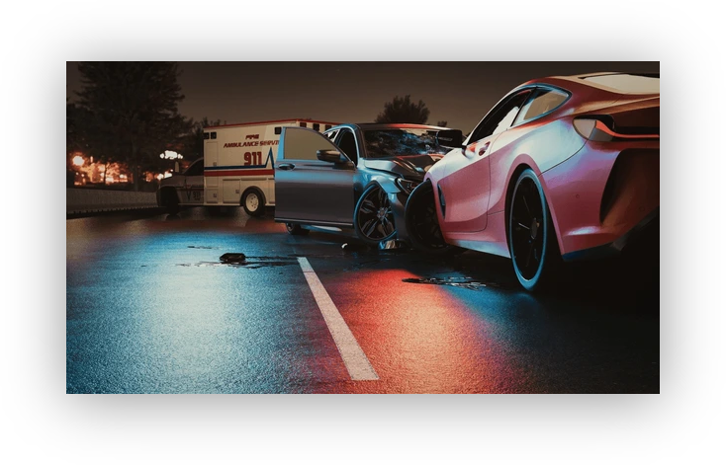
DATA 6545 Final Project Accident Dataset Prediction
Group 6: Peter Bonnanzio, Kevin Carcamo, Vini Pasholli

Slide 2
Problem Definition
Objective: Predict high-severity accidents (Severity >= 3)
Reframe as binary classification: is_high_severity
Operational goal: minimize false negatives (safety-critical)
Data source: US Accidents (Kaggle)
Notes:
State objective and why recall is prioritized.

Slide 3
Data Ingestion & Environment
Colab environment; Google Drive mounted
Paths defined for raw/interim/processed/artifacts
Primary dataset: US_Accidents_March23.csv
DuckDB used for scalable querying and Parquet export
Notes:
Explain reproducible directory structure.

Slide 4
Development Sample Creation
DuckDB COPY from CSV with LIMIT 300,000
Output: dev_sample.parquet (interim)
Rationale: manageable compute while preserving distribution
Ignore CSV errors to ensure robust ingestion
Notes:
Discuss tradeoff between scale and speed.

Slide 5
Deterministic Data Split
Create split_bucket via hash(row_number()) % 100
Train: <70, Validation: 70–85, Test: >=85
Outputs: train.parquet, val.parquet, test.parquet
Ensures reproducibility across runs
Notes:
Highlight deterministic vs random split.

Slide 6
Split Sizes
Train: 209,511 rows
Validation: 44,995 rows
Test: 45,494 rows
Total: 300,000 rows
Next slide visualizes the row counts generated by the deterministic split.
Notes:
Confirm expected 70/15/15 proportions.

Slide 7
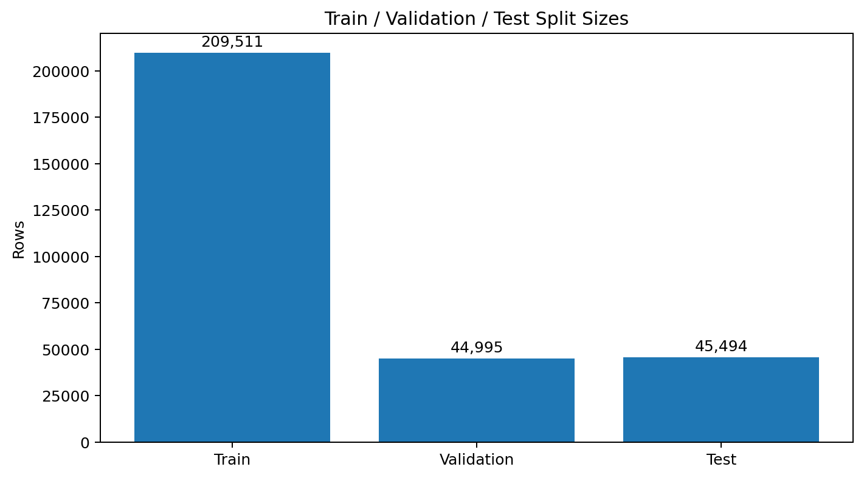
Visualization: Split Size Check
Notebook split sizes confirm the 70/15/15 design and preserve the 300,000-row development sample.

Slide 8
Class Distribution
Severity 2 ~63%, Severity 3 ~37%
Severity 1 and 4 <0.1% each (rare)
Distribution consistent across splits
Implication: strong class imbalance
Next slide visualizes the severity distribution across train, validation, and test.
Notes:
Focus on 2 vs 3 separation.

Slide 9
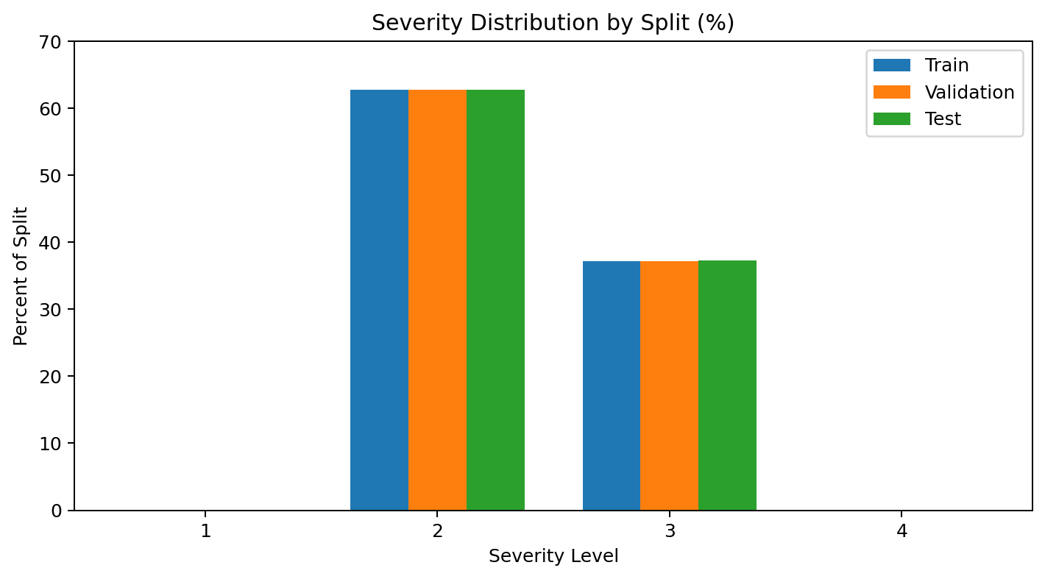
Visualization: Severity Distribution by Split
Severity 2 and 3 dominate across all splits; rare classes remain below 0.1%.
Notes:
Insert notebook plot showing consistent distributions.

Slide 10

Column Inventory
~47 columns: identifiers, time, geospatial, weather, road indicators
Many columns contain null values
Type inconsistencies (End_Lat/End_Lng as VARCHAR)
High-cardinality text fields present (Description, Street)
Notes:
Motivates cleaning and feature selection.

Slide 11
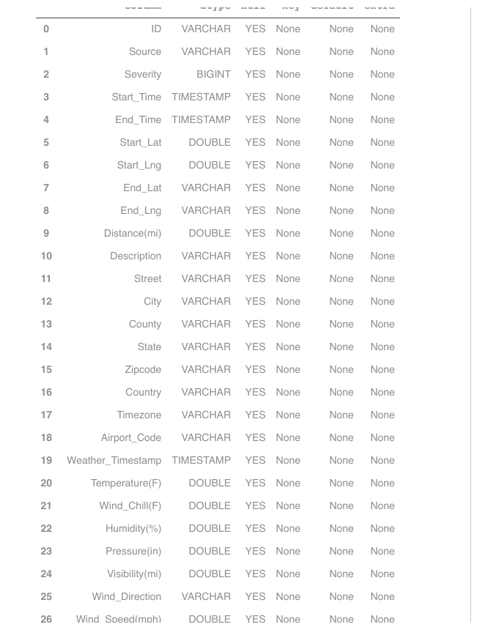
Visualization: Column Inventory Snapshot
Notebook output shows mixed feature types: identifiers, timestamps, geospatial fields, weather variables, and roadway indicators.

Slide 12
Feature Schema Definition
Target: Severity
Drop columns: ID, Source, Description, Street, County, Zipcode, Country, Airport_Code, Weather_Timestamp, End_Time, row_hash
Numeric features: 12
Boolean features: 13; Categorical features: 9
Notes:
List categories explicitly.

Slide 13
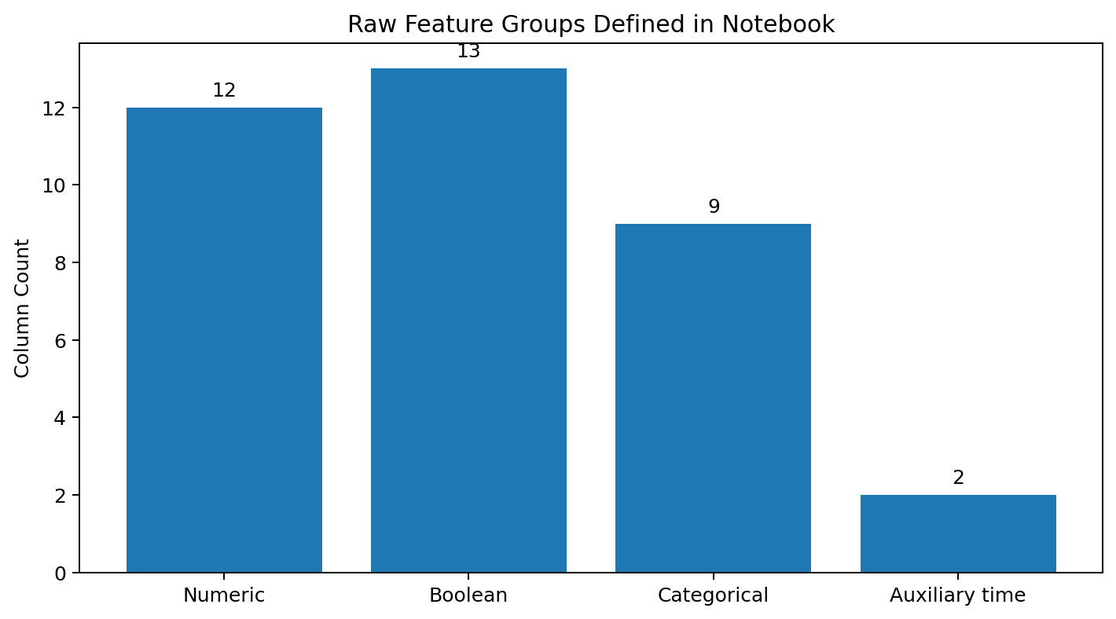
Visualization: Feature Type Breakdown
The retained modeling schema is organized into numeric, boolean, categorical, and auxiliary time columns.

Slide 14
Type Correction & Cleaning Rules
TRY_CAST End_Lat/End_Lng to DOUBLE
Boolean fields COALESCE -> 0/1 integers
Categorical NULL/blank -> 'Unknown'
Preserve Start_Time for feature engineering
Notes:
Explain SQL transformations.

Slide 15
Feature Engineering (SQL)
Derive: start_year, start_month, start_day
Derive: start_dayofweek, start_hour
is_weekend = CASE WHEN dayofweek in (0,6) THEN 1 ELSE 0
Exclude post-incident features (no leakage)
Notes:
All features computable at prediction time.

Slide 16
Clean Feature Tables
Apply transformations to train/val/test via DuckDB
Outputs: *_features.parquet
Consistent schema across splits
Ready for modeling and EDA
Notes:
Emphasize reproducibility.

Slide 17
QA Checks on Features
Rows: 209,511 (train)
High severity rate ~0.372
Avg distance ~0.0486 miles
Sanity check on distributions
Notes:
Validate plausibility.

Slide 18
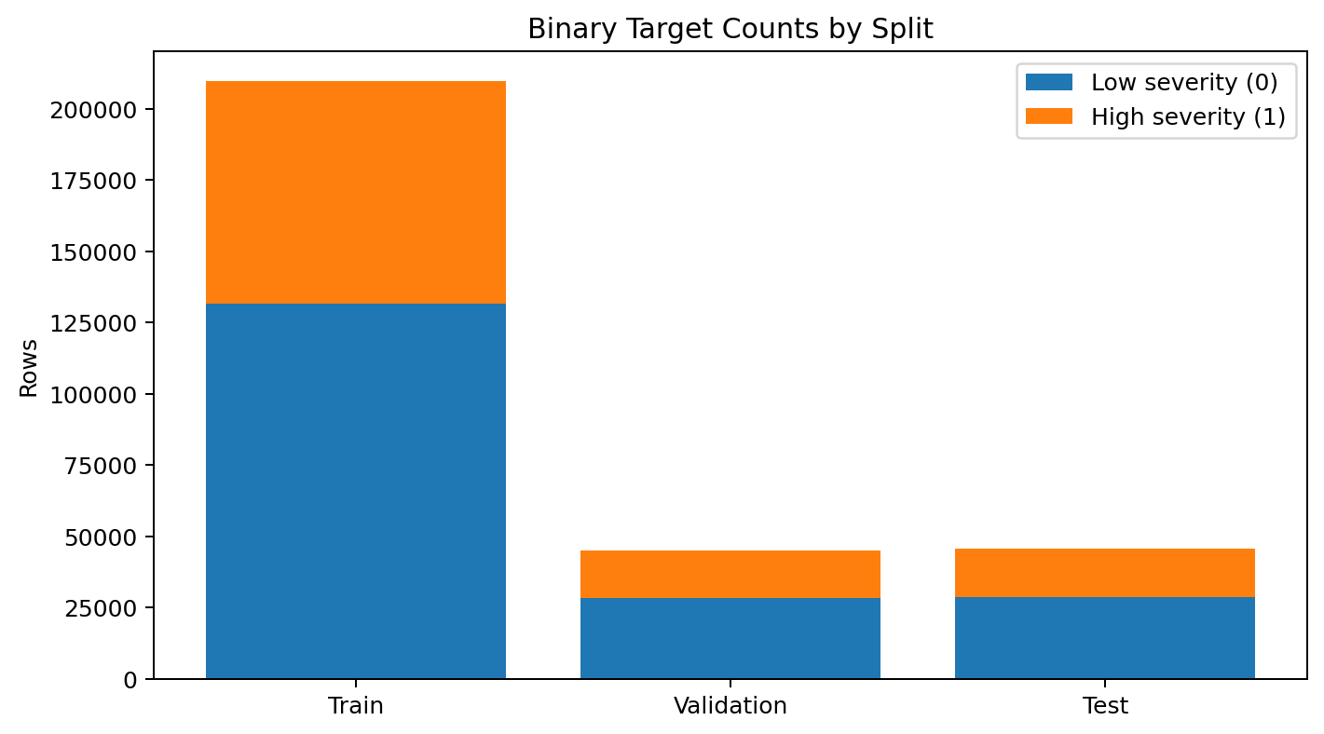
Visualization: Binary Target Counts
The binary target remains stable across train, validation, and test splits at roughly 37% high-severity cases.

Slide 19
Binary Target Construction
is_high_severity = (Severity >= 3).astype(int)
Positive rate ~37% across splits
Consistent class balance maintained
Separation of X and y for modeling
Notes:
Justify binary framing.

Slide 20
Leakage Guardrails & Integrity
Exclude
Exclude 'Severity' and target from features
Check
Check overlap via hashes across splits
Verify
Verify feature column alignment
Detect and document
Detect and document duplicate rows
Notes:
Mention minimal overlap observed.

Slide 21
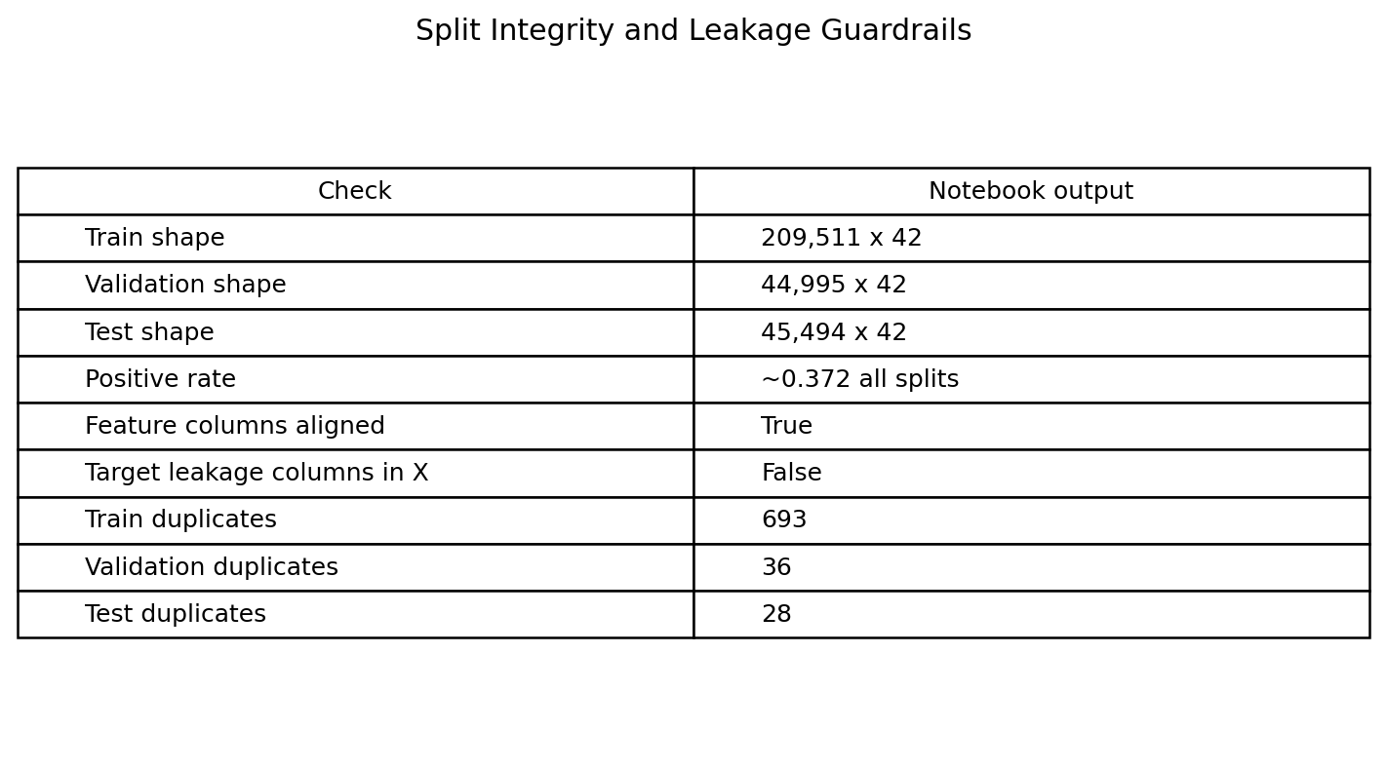
Visualization: Split Integrity + Leakage Checks
The notebook verifies target leakage removal, column alignment, and duplicate counts across splits.

Slide 22
Preprocessing Pipeline
ColumnTransformer
Numeric: SimpleImputer(median) + StandardScaler
Categorical: SimpleImputer(most_frequent) + OneHotEncoder(handle_unknown='ignore')
Fit on train, transform on val/test
Notes:
Avoid leakage in preprocessing.

Slide 23
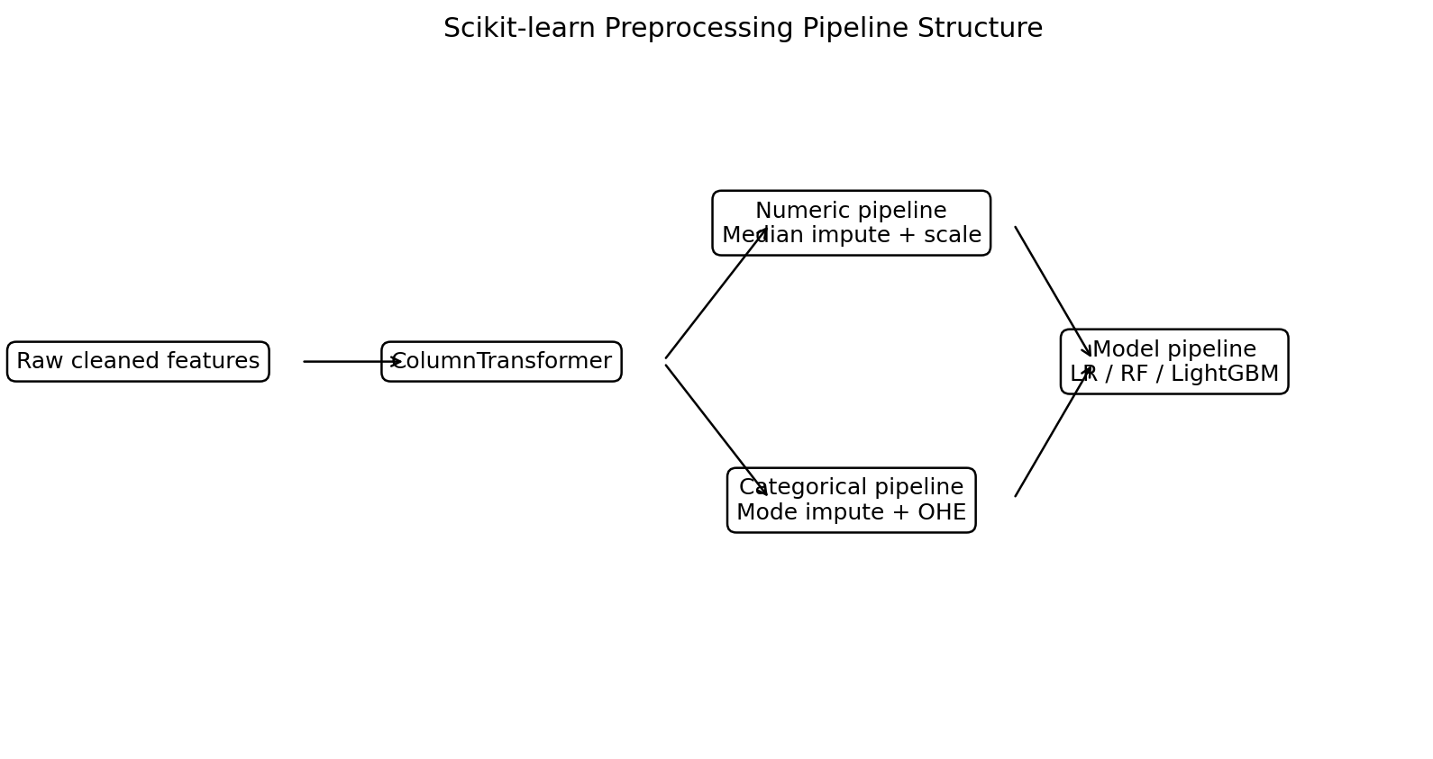
Visualization: Preprocessing Pipeline Flow
The pipeline separates numeric and categorical transformations before model training.

Slide 24
Feature Counts After Prep
~29 numeric features (incl. engineered)
~9 categorical features (one-hot encoded)
Sparse representation from OHE
Consistent feature space across splits
Notes:
Note dimensionality increase.

Slide 25
Baseline Model: Logistic Regression
Regularized logistic regression
class_weight='balanced'
Serves as interpretable benchmark
Fast training and baseline metrics
Notes:
Discuss linear decision boundary.

Slide 26
Tree-Based Models
Random Forest: non-linear ensemble baseline
LightGBM: gradient boosting, handles imbalance
Both integrated into sklearn Pipeline
Compared on validation metrics
Notes:
Motivate choice of LightGBM.

Slide 27
Evaluation Metrics
Threshold = 0.50 to prioritize recall over false positives.
Precision, Recall, F1 (macro/weighted)
ROC-AUC and PR-AUC
Confusion matrix
Threshold analysis for recall prioritization
Next slide compares validation metrics across the three candidate models.
Notes:
Recall emphasized.

Slide 28
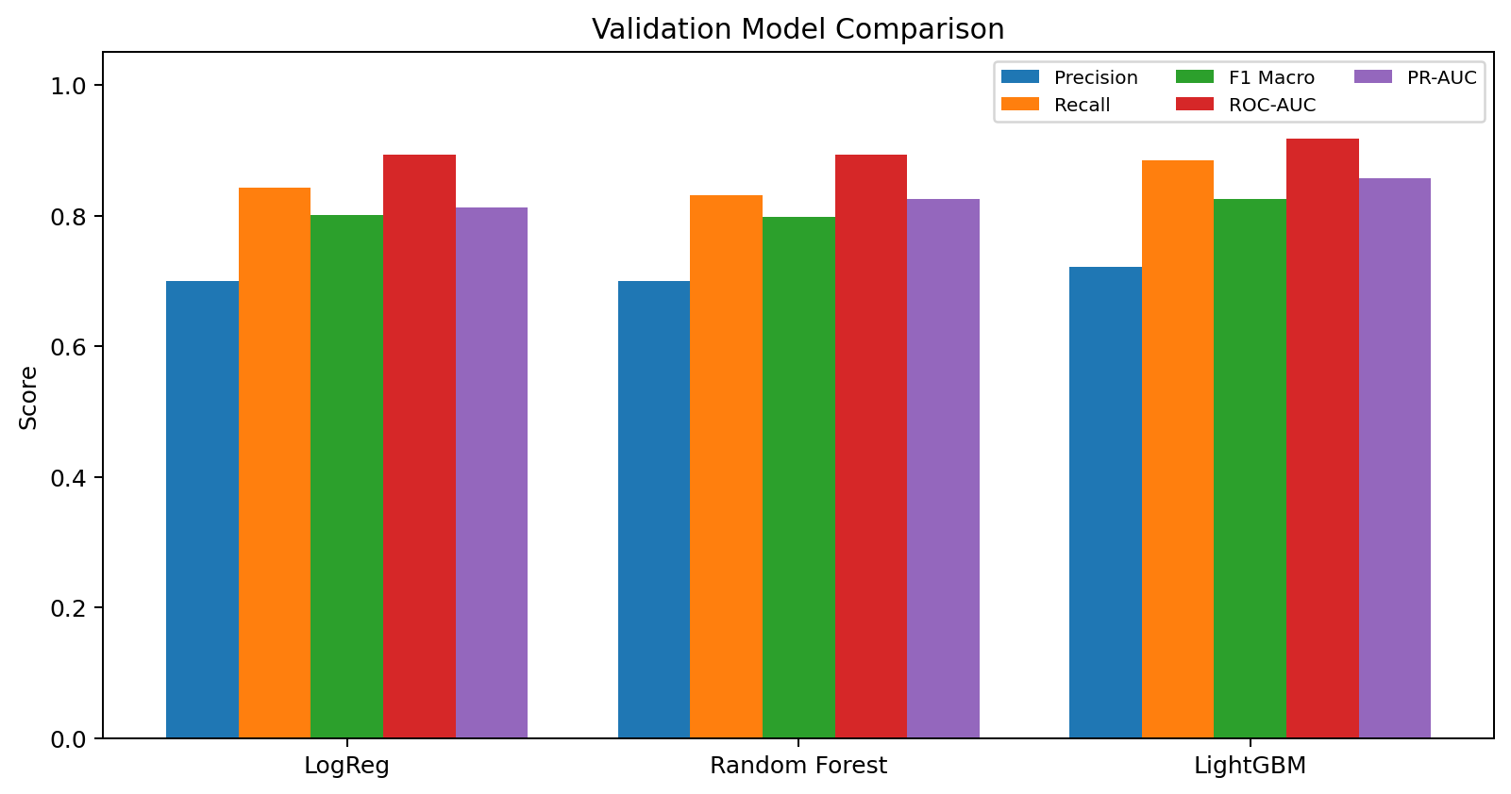
LightGBM outperforms Logistic Regression and Random Forest on recall, ROC-AUC, and PR-AUC.
Visualization: Validation Model Comparison
LightGBM produces the best overall validation performance, especially on recall, ROC-AUC: ~0.92, and PR-AUC: ~0.86.

Slide 29
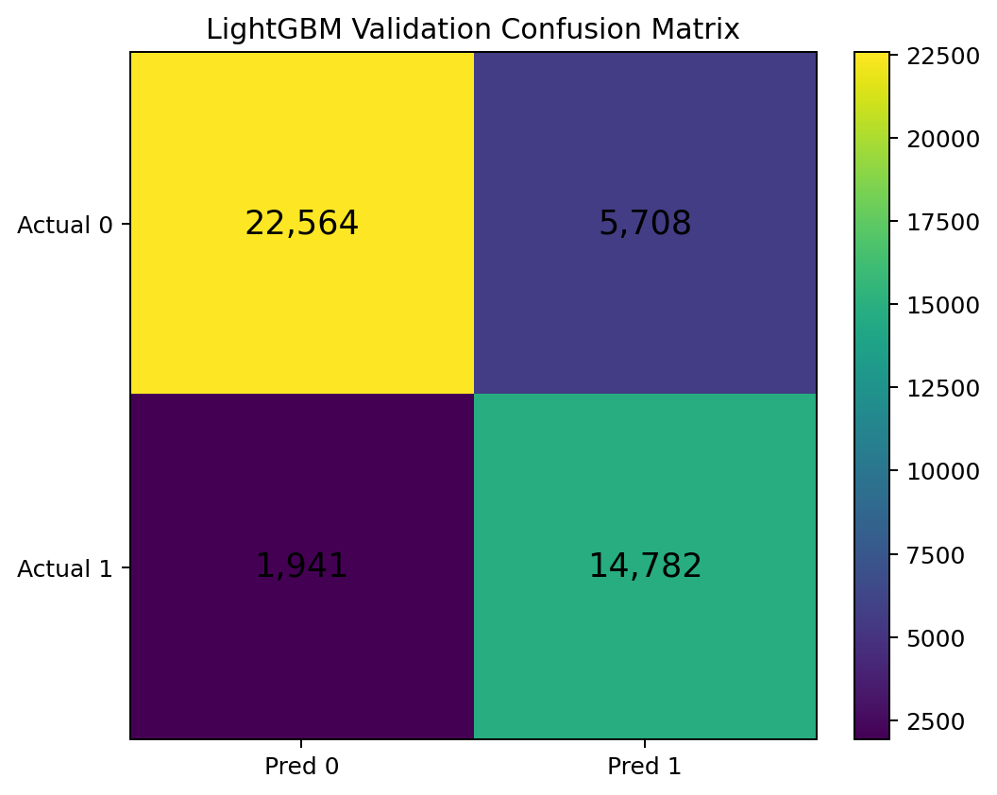
Visualization: Confusion Matrix (Validation)
Test Set Confusion Matrix (Threshold = 0.50) for LightGBM at threshold 0.50.
Correctly identifies most severe accidents (14,782 true positives)
Strong ability to detect non-severe cases (22,564 true negatives)
False negatives are low (1,941) → fewer missed severe accidents (key objective)
Some false positives (5,708) → acceptable tradeoff for higher recall
Notes:
Insert matrix plot from notebook.

Slide 30
Champion Model: LightGBM
Precision: 0.73
Recall: 0.88
F1 (macro): 0.83
High recall reduces missed severe accidents
Notes:
State why this is selected.

Slide 31
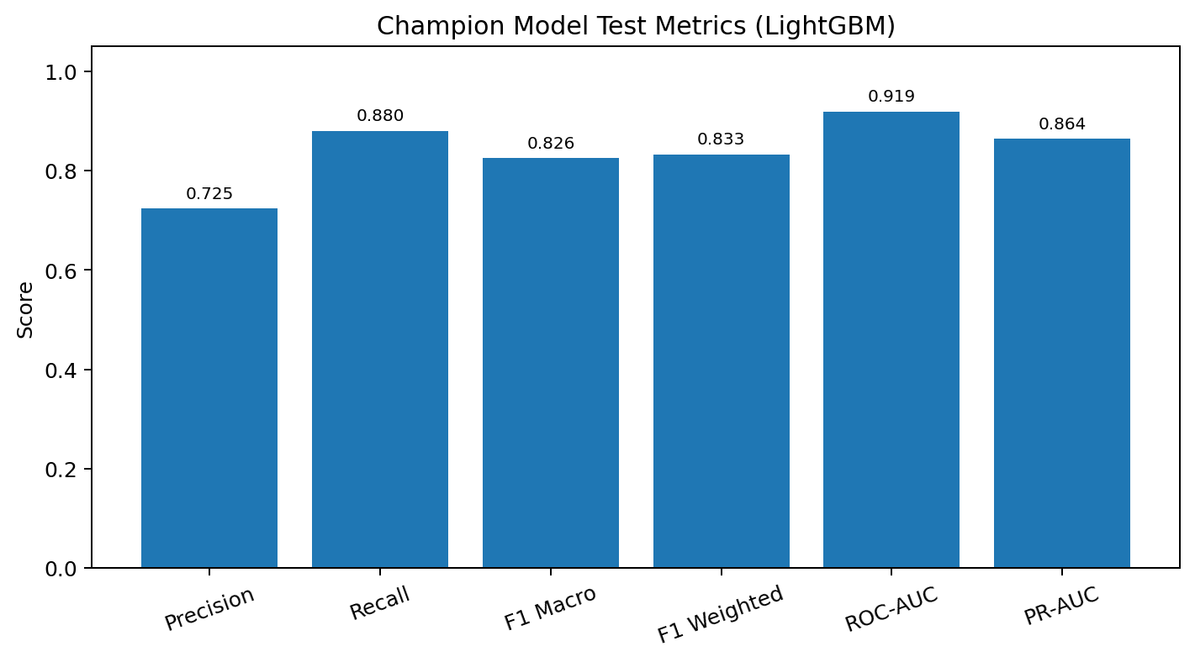
Visualization: Champion Test Metrics
The locked LightGBM champion generalizes well on the test set.

Slide 32
Error Analysis
True Negatives: 23,048
True Positives: 14,924
False Positives: 5,494
False Negatives: 2,028
Next slide visualizes the final test-set confusion matrix.
Notes:
Focus on minimizing FN.

Slide 33

Visualization: Test Confusion Matrix
The test confusion matrix highlights the operational tradeoff: high true positives with controlled false negatives.

Slide 34
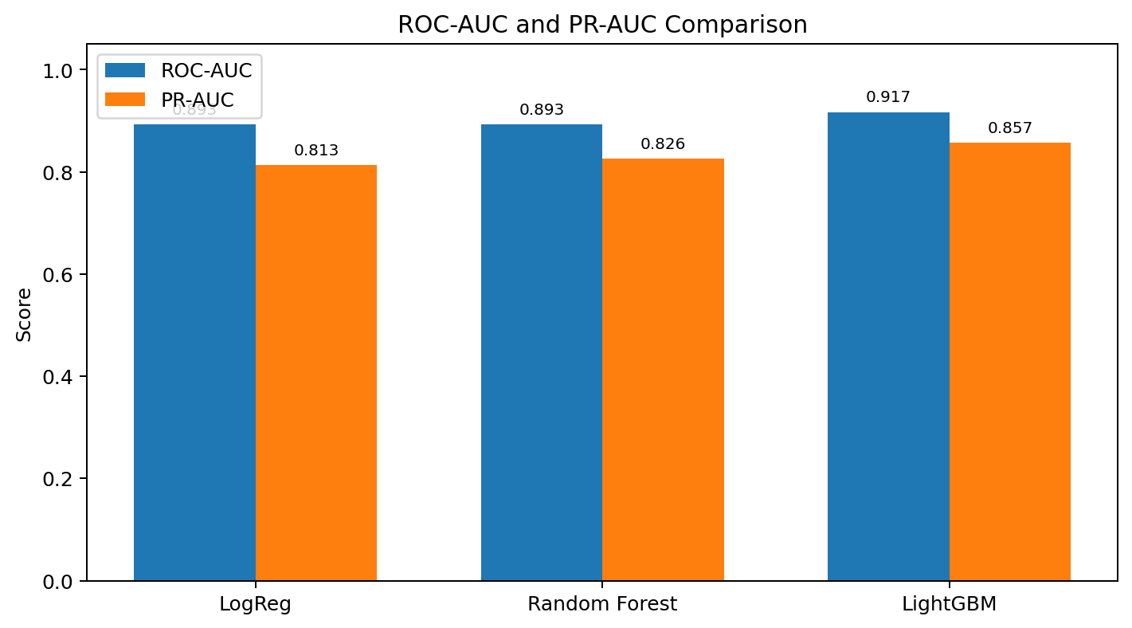
Visualization: ROC-AUC: ~0.92 / PR-AUC: ~0.86 Comparison
LightGBM has the strongest ROC-AUC: ~0.92 and PR-AUC: ~0.86 among the tested models.
Notes:
Insert curves from notebook.

Slide 35
Feature Importance / Explainability
Use model-based feature importance
SHAP values for local/global explanations
Identify drivers: weather, visibility, time, road indicators
Supports interpretability
Following slides show SHAP outputs from the notebook.
Notes:
Tie to operational trust.

Slide 36
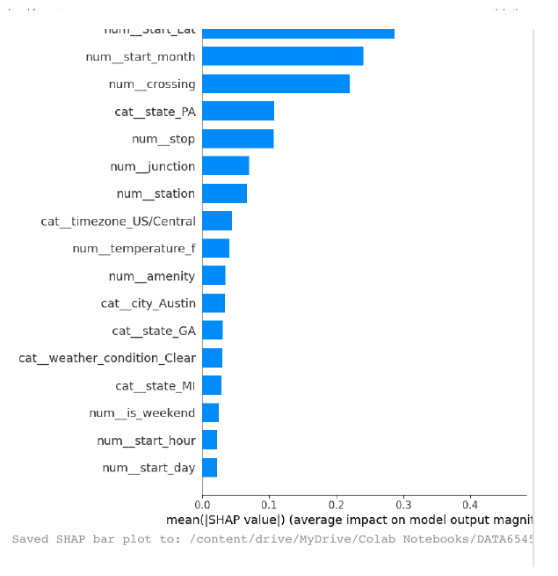
Visualization: SHAP Feature Importance Bar Plot
Notebook SHAP bar plot ranks the most influential features by mean absolute SHAP value.

Slide 37
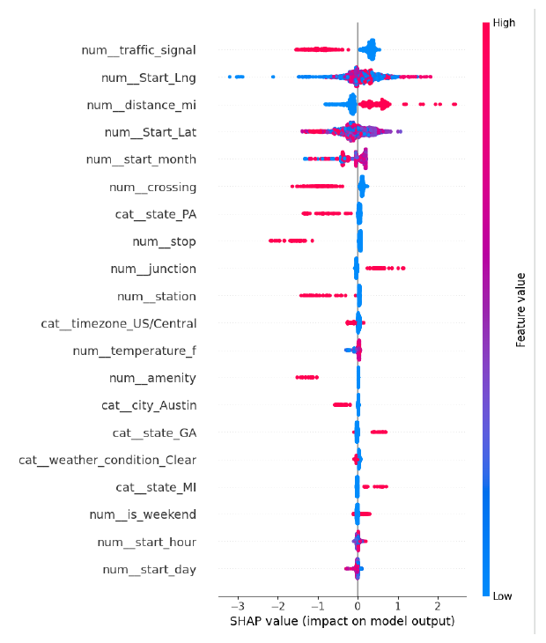
Visualization: Feature Importance / SHAP
SHAP summary from notebook: traffic signal, longitude, distance, latitude, and month appear among strongest drivers.
Notes:
Insert plot(s) from notebook.

Slide 38
MLflow Experiment Tracking
Tracking URI: SQLite in project artifacts
Log params, metrics, artifacts
Experiment: DATA6545_USAccidents_Severity
Artifacts persisted on Drive
Notes:
Reproducibility and comparison.

Slide 39
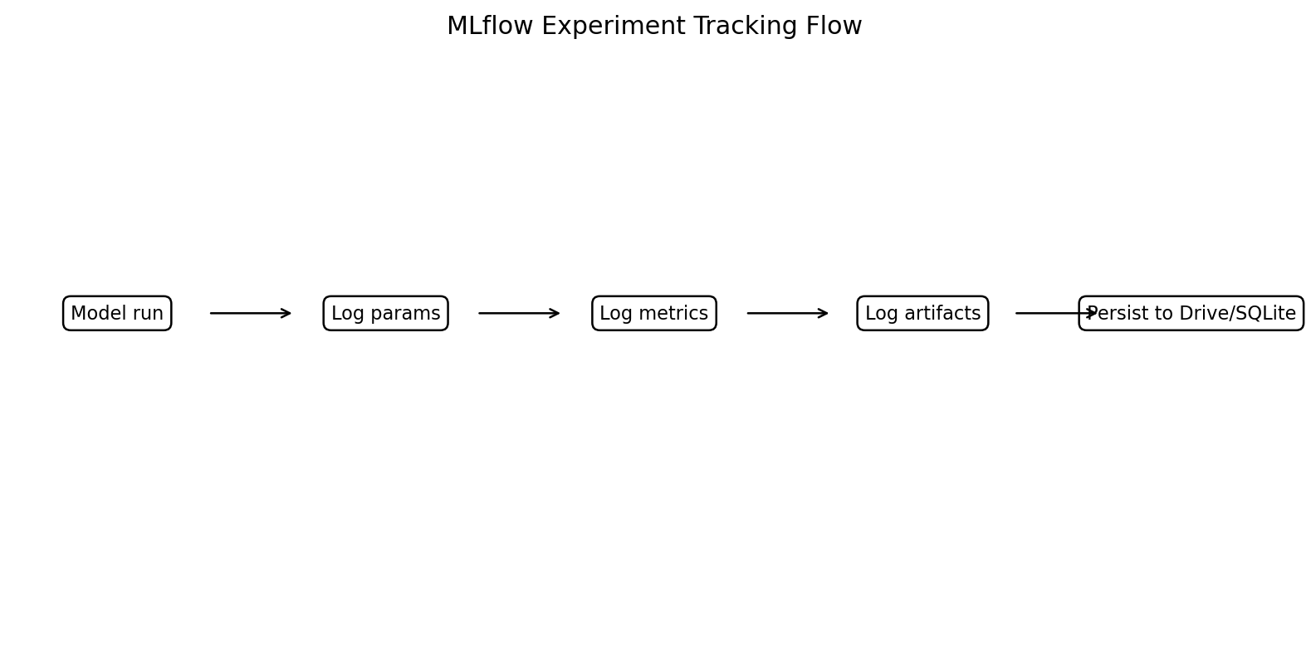
Visualization: MLflow Tracking Flow
Experiment metadata, metrics, thresholds, and artifacts are logged for reproducibility.

Slide 40
Model Packaging
Serialize pipeline (preprocessor + model)
Use joblib/pickle
Ensure consistent preprocessing at inference
Versioned with MLflow
Notes:
Single artifact for inference.

Slide 41
Deployment Design
Flask API endpoint for predictions
Docker container for portability
Request -> preprocess -> predict -> response
Ready for integration into systems
Notes:
High-level flow only.

Slide 42
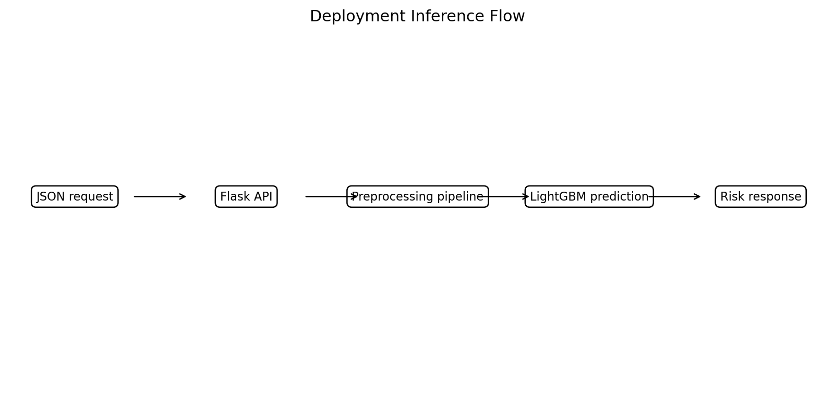
Visualization: Flask/Docker Inference Flow
The deployment design wraps preprocessing and prediction behind an API response cycle.

Slide 43
Limitations
Class imbalance persists (~37% positive)
Duplicate rows present (documented)
Missing data handled via imputation
Feature scope limited to available fields
Notes:
Acknowledge constraints.

Slide 44
Ethical Considerations
Potential geographic/infrastructure bias
False negatives may delay response
Transparency required for stakeholders
Model supports, not replaces, human decision-making
Notes:
Discuss risk and mitigation.

Slide 45
Summary
End-to-end pipeline: ingestion -> features -> modeling -> tracking -> deployment
Deterministic splits and leakage controls
LightGBM achieves high recall (0.88)
Framework supports reproducible, deployable ML
Notes:
Concise wrap-up.

Slide 46
Business Impact
Emergency Response: Faster identification of severe accidents
Insurance: Improved claim prioritization
Planning: Infrastructure improvements in high-risk areas
Safety: Reduced loss-of-life via proactive intervention

Slide 47
Executive Takeaway
High recall (0.88) enables proactive detection of severe accidents
LightGBM delivers best performance
Supports safety-focused decisions
Predicts high-severity accidents using contextual features
Pipeline is reproducible and deployment-ready

Slide 48
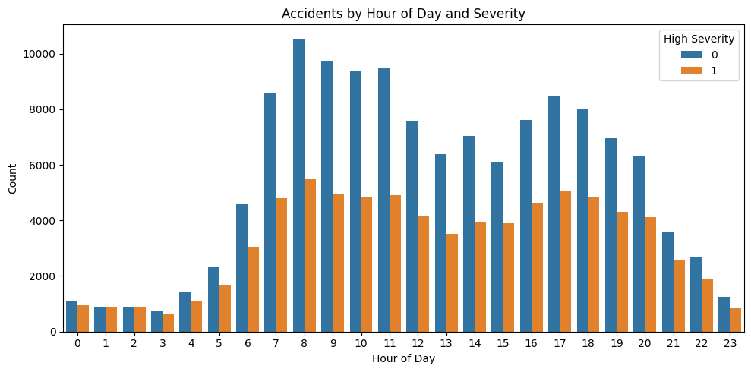
Temporal Patterns: Hour of Day vs Severity

Slide 49
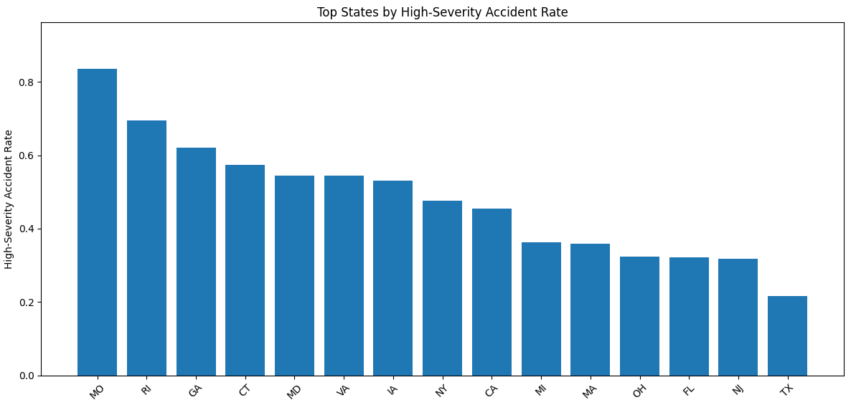
Geographic Variation: Top States by Severity Rate

Slide 50
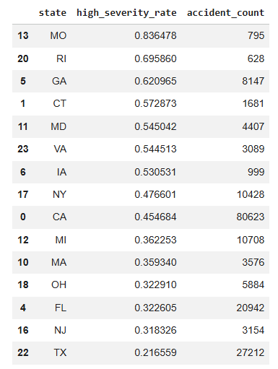
Geographic Variation: Top States by Severity Rate
High-Severity Accident Rate by State
Approach
Defined target: Severity ≥ 3 → high severity
Aggregated by state:
Mean → high-severity rate
Count → accident volume
Filtered states with ≥ 500 records
Selected top 15 by severity rate
Key Observations
Severity rates vary significantly across states
Some states (MO, RI) show high rates but smaller samples
GA, MD, VA: high severity rates with strong volume
CA, TX: high volume ≠ highest severity rates
Takeaway
Severity is not driven by accident frequency alone
Geographic patterns reflect underlying conditions
Supports need for predictive modeling over simple counts

